Slide 1
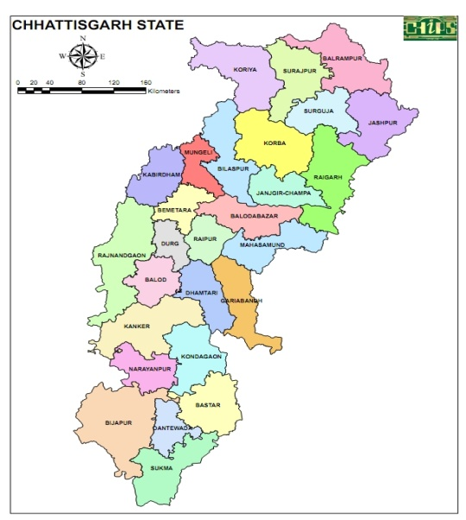
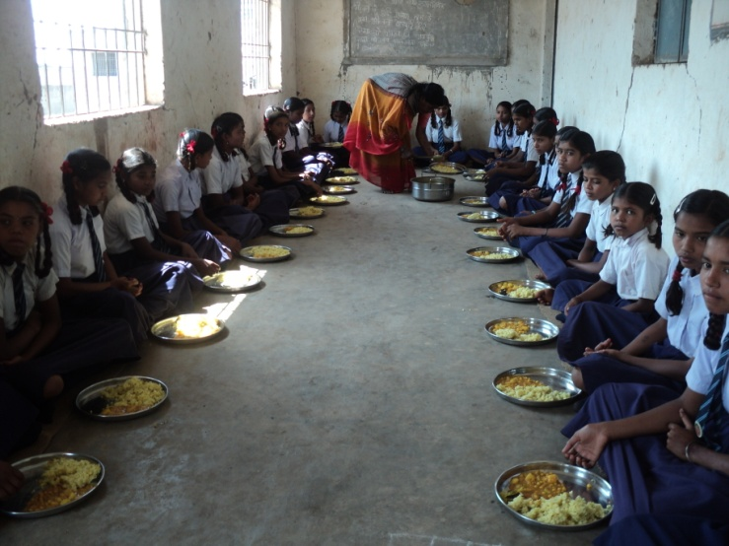
Mid Day Meal Scheme In Chhattisgarh
Annual Work Plan & Budget
2018-19
1

Slide 2
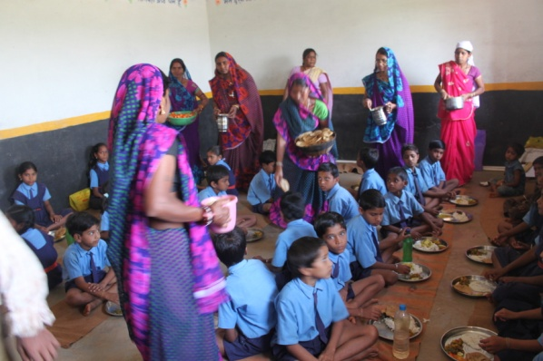
Best Practices
State Government has involved the women’s Self Help Groups in distribution of mid day meal in rural areas. In this way the government has generated employment for the women of the state, thus empowering the women . A total of 42926 schools MDMS are run by Women's Self Help Groups in the state.
2

Slide 3
Best Practices
State Government has taken a decision that for Mid Day Meal funds are released to DEOs/BEOs in first month of financial year without waiting release of funds by central for Six month.
The Head Masters who were involved in cooking of meals have now been disengaged. They will now only monitor the programme.
3

Slide 4
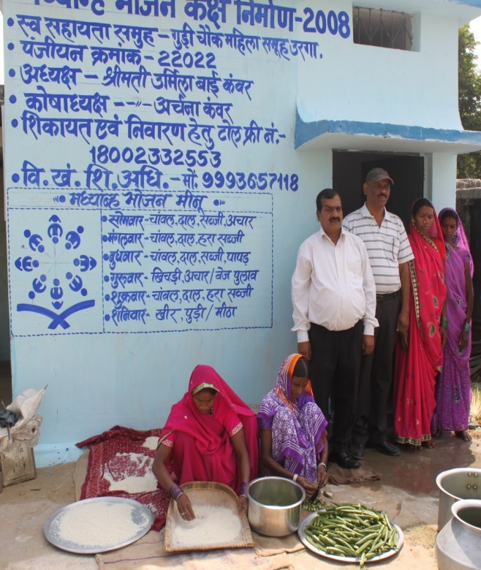
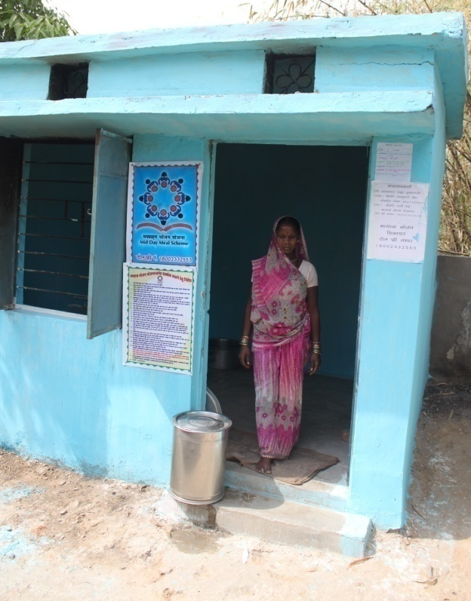
Best Practices
4. A 21 point instruction has been written on the wall of school. It includes important telephone and mobile numbers for collecting all and sundry information from the public.
4

Slide 5
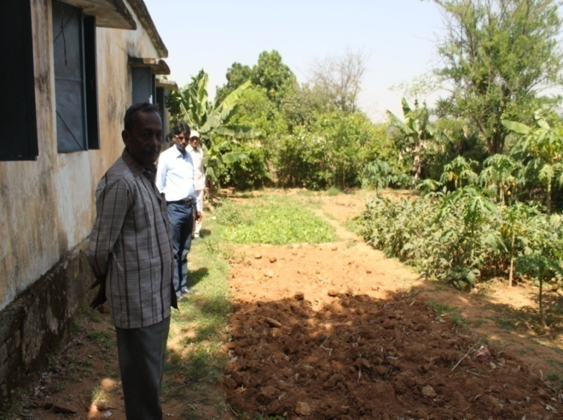
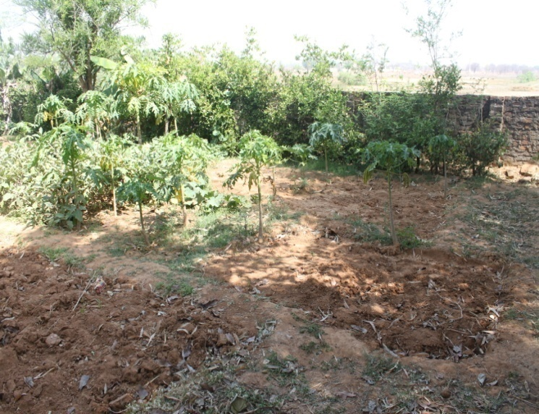
Best Practices
5. Funds are electronically transferred to cooking agencies and cook- cum -helpers to ensure timely payment.
6. To promote kitchen gardens in schools, State Steering cum Monitoring Committee meeting held on 10-02-2017, it is decided that Agriculture and Horticulture department will have provide free vegetable seeds to Women’s Self Help Groups.
5

Slide 6
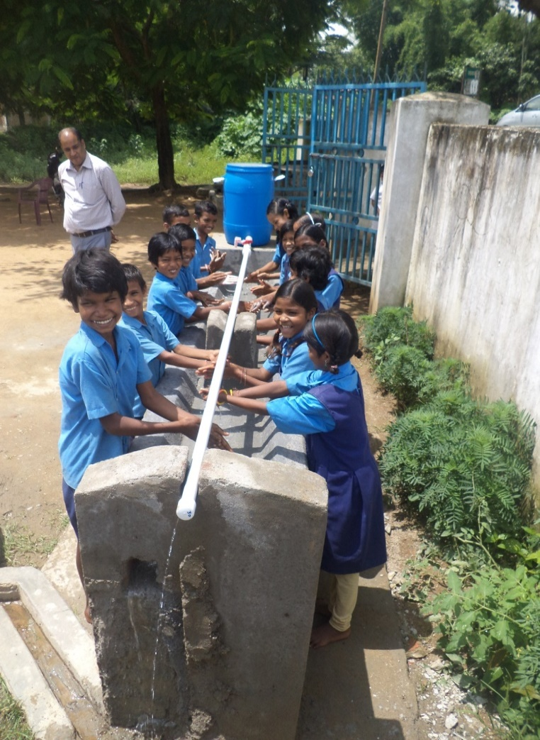
Best Practices
7. Construction of Multi tap Hand wash Platform
Multi-Tap hand wash platforms have been constructed in few schools of state. District Collectors have been instructed that they will provide funds from DMF for construction of Multi-Tap hand wash platforms
6

Slide 7
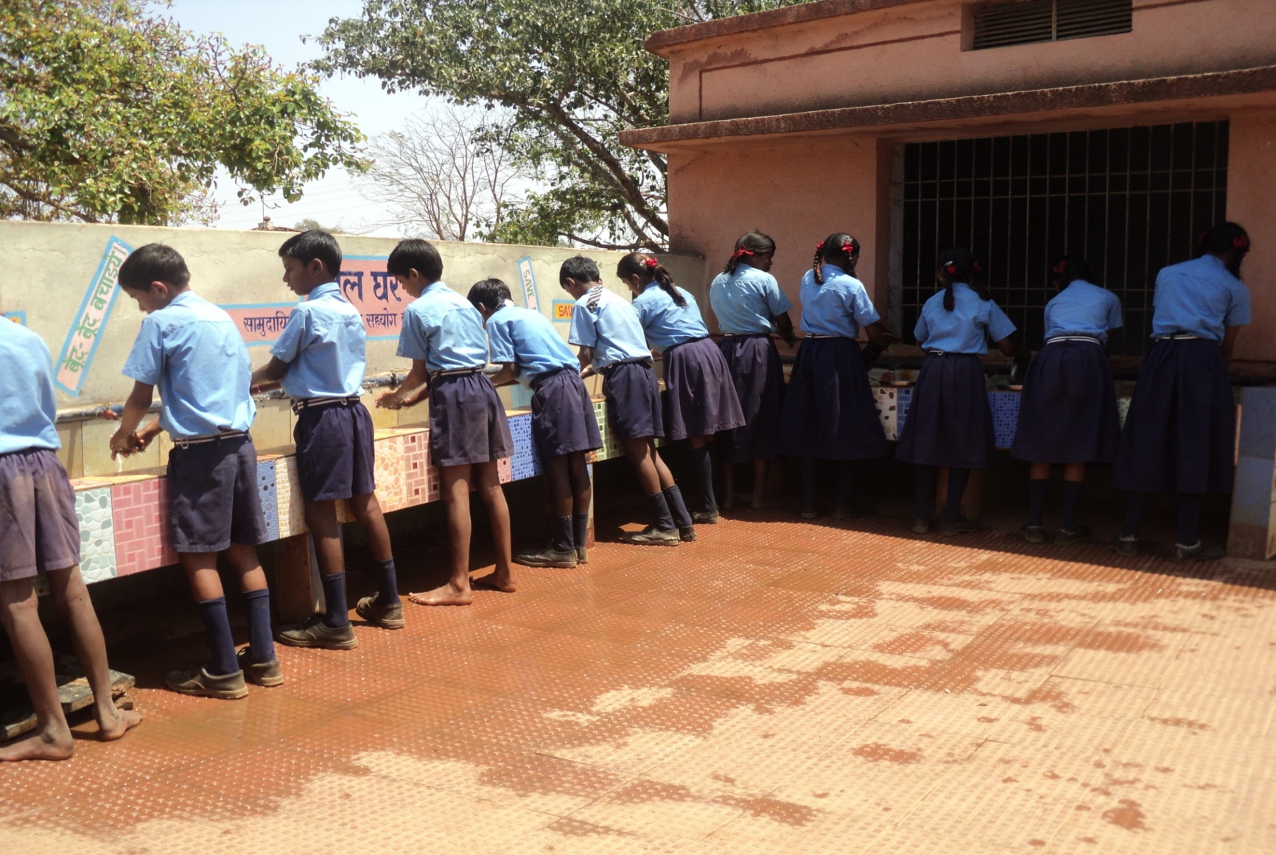
Govt. School Potiya Dist Durg
Platform for hand wash constructed by SMDC and Gram Panchayat
7

Slide 8
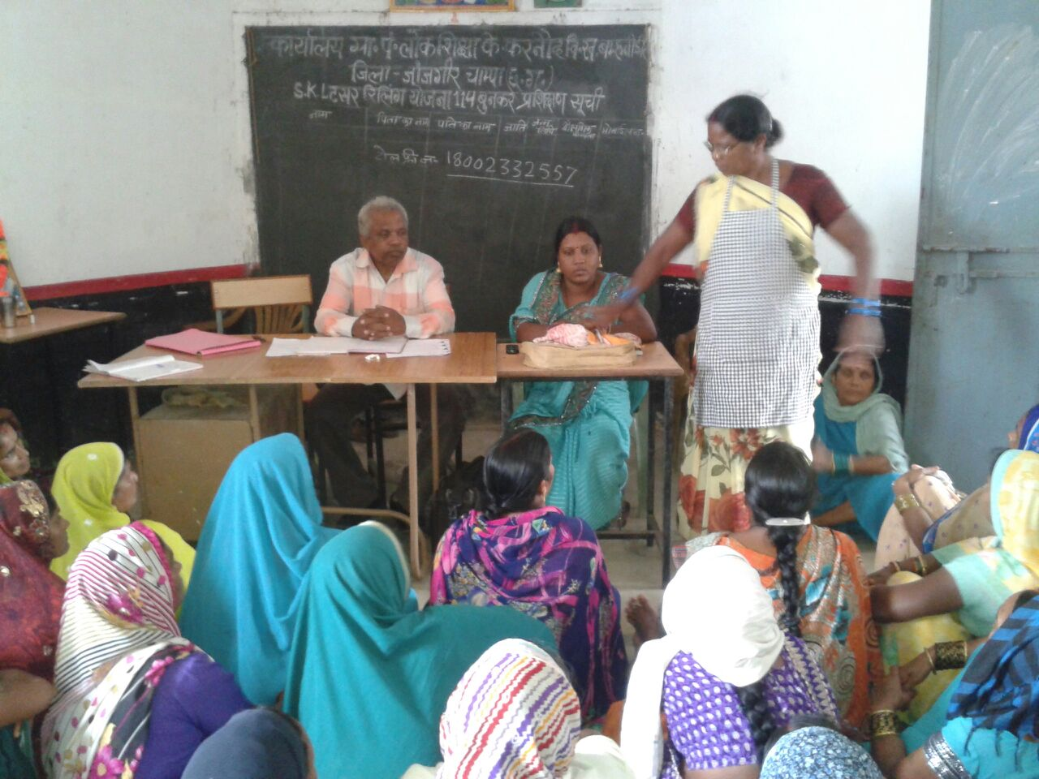
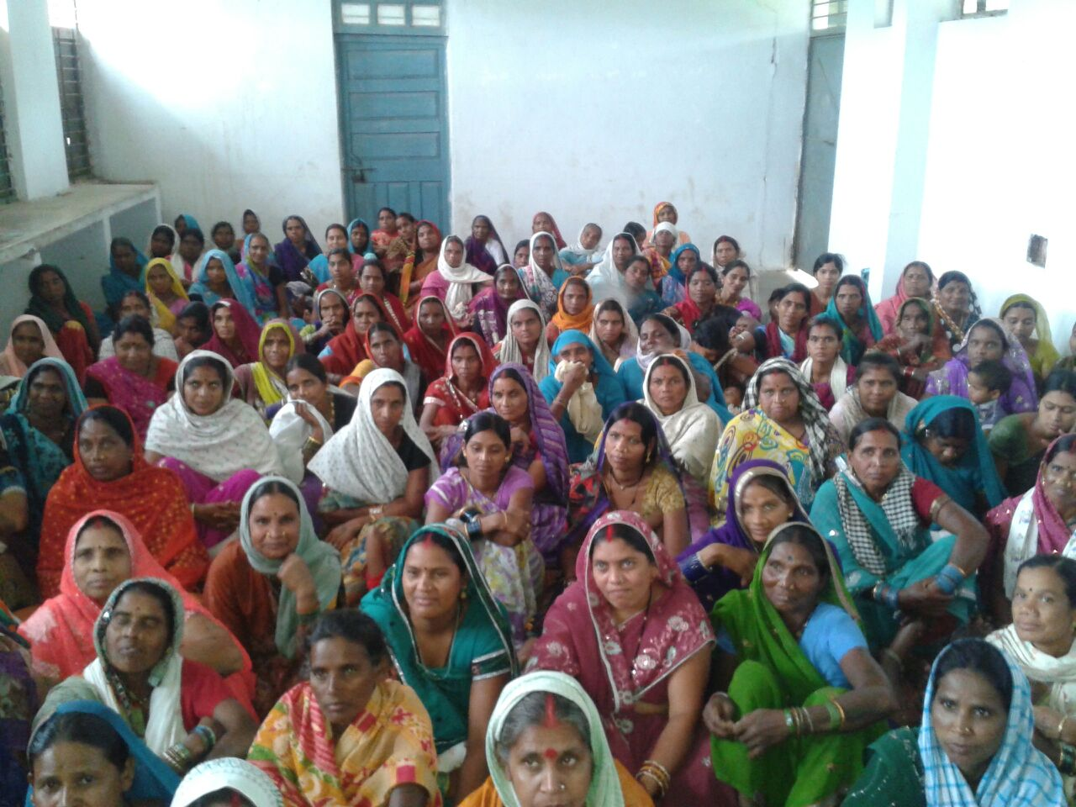
Best Practices
8. Cooks Training Programme
Cook cum helper Training programme is underway at cluster level in all districts on a rotational basis so that all cooks cum helper get training at least once in a year.
8

Slide 9
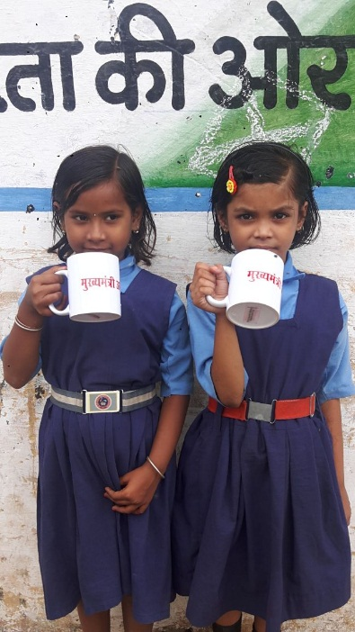
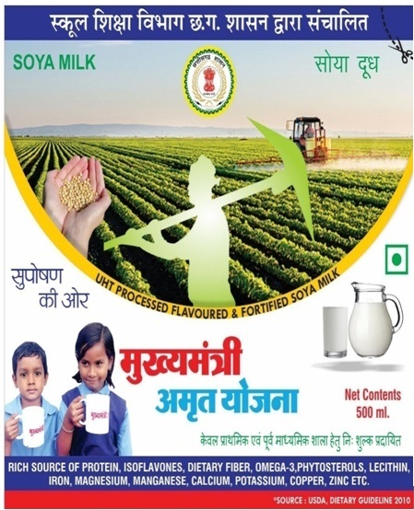
Best Practices
9. Mukhya Mantri Amrit Yojna
In Chhattisgarh State, flavoured Soya Milk is Given in 2 District i.e. Kabirdham and Bastar as Pilot Project.
Soya Milk is given once in a week. It is provided for Primary School Children 100 ml and for Upper Primary School children 150 ml per child
9

Slide 10
MDM Coverage
S.NO. | Particulars | Number of Schools which are eligible for MDM | Covered under MDM | Proposal for 2018-19
1 | PRIMARY SCHOOLS | 31,278 | 31,278 | 31,278
2 | UPPER PRIMARY SCHOOLS | 13,555 | 13,555 | 13,555
10

Slide 11
MDM ENROLLMENT AND BENEFICIARIES
S. N. | Stage | Enrollment as on 30-09-2017 | MDM-PAB approval for 2017-18 | Average number of beneficiaries during 1/4/17 to 31/03/18 | Average number of children Proposed for 2018-19
1 | 2 | 3 | 4 | 5 | 6
1 | PRIMARY | 18,94,494 | 17,50,000 | 15,78,895 | 17,00,000
2 | UPPER PRIMARY | 12,35,786 | 11,11,000 | 10,08,263 | 11,00,000
 | Total | 31,30,270 | 28,61,000 | 25,87,155 | 28,00,000
11

Slide 12
Coverage of MDM Days
School | 2017-18
 | Approved from 1st April 2017 to 31st March 2018 | Actual MDM Days (Average)
Primary | 240 | 233
Upper Primary | 240 | 233
12

Slide 13
Implementation Agency in State
Name of Implementing Agency | Number of agency | Schools Covered
Women's Self Help Group | 42405 | 42405
Gram Panchayat | 38 | 38
NGO | 5 | 675
Others (SMC,HM,VEC etc.) | 1715 | 1715
Total |  | 44833
13

Slide 14
Drought affected areas
In Chhattisgarh out of 146 blocks, 96 blocks have been declared drought affected blocks during revenue year 2017-18.
(1st Oct 2017 – 30th Sept. 2018)
School | Children | No. of Days Proposed
Primary | 13,54,738 | 46
Upper Primary | 9,04,505 | 46
Total | 22,59,243 | 46
14

Slide 15
Proposal for Annual work Plan and Budget
2018 &2019
Particular | Approved for 2017-18 |  | Proposal for 2018-19
 | Primary | Upper Primary | Primary | Upper Primary
Number of Schools | 31]383 | 13]591 | 31]278 | 13]555
Enrollment | 18]94]494 | 12]35]786 | 19]89]218 | 12]97]575
Average Beneficiaries | 15]78]895 | 10]08]263 | 17]00]000 | 11]00]000
MDM Days | 240 | 240 | 240 | 240
Cooking Cost per per day per student in Rs | 4.78 | 6.48 | 5.13 | 6.95
Cooks cum Helper Honorarium | Rs 1200 per month |  | Rs1500 per month
Number of Cooks cum Helper | 62]056 | 31]364 | 62]056 | 31]364
15

Slide 16
Proposal for LPG Gas Cylinder and Chulha
State need fund Rs 3466.44 lakh for LPG GAS Cylinder and Chulha.
District wise details are given in Table AT-33
16

Slide 17
Issues
Less Honorarium of Cook Cum Helper
Since 2010 in accordance with Central Government the Honorarium of Cook Cum Helper is prescribed 1000 Rs per month for 10 month in a year.
In accordance with 60:40 ratio the central Govt. gives its contribution of Rs 600 and State Govt. gives 400 Rs.
In Chhattisgarh State the Cook Cum Helper are given the additional honorarium of 200 Rs per month, so in this manner state govt is bearing around 18 crore 68 lakhs per year.
17

Slide 18
The Cook Cum Helper Union has put a petition in Honourable Chhattisgarh High Court for the demand to increase Honorarium as per accessories Handy Accessories Salary.
Transportation Cost enhancement from Rs 75/- per Quintal to at least Rs 107/- per Quintal.
Kitchen Shed which are constructed in 2007-08 required repairing therefore Funds should be provided by MHRD for repairing work.
18

Slide 19
4. Lab Testing of Cooked Food
Under MDM Rules, 2015, quality, Protein and Calorie value of meals has to be checked. While quality of dry ration can be tested, in The State Govt. laboratory but it is not possible to determine the quality of a hot cooked meal.
Calorie and Protein value of Cooked Food can be Tested from NABL Lab which is very costly so additional funds to be provide in MME for that.
19

Slide 20
Thank You
20

